Slide 1
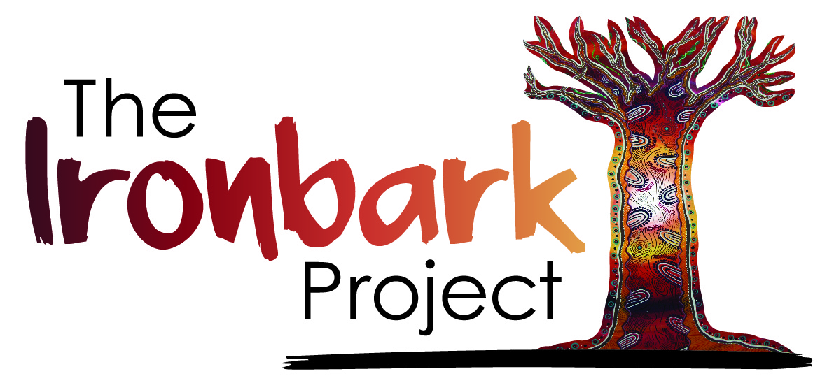

Slide 2
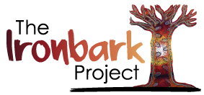

What is the Ironbark Project?
The Ironbark Project is a healthy ageing research project, it compares two different programs. Both programs are based around a yarning circle that is ongoing and delivered at any site or service by local mob that are trained by the Ironbark Team.
The Ironbark: Standing Strong program is a weekly
exercise and yarning circles that include health topics around around falls prevention.
The Ironbark: Healthy Community program is a weekly program that involves social activities and yarning circles.

Slide 3
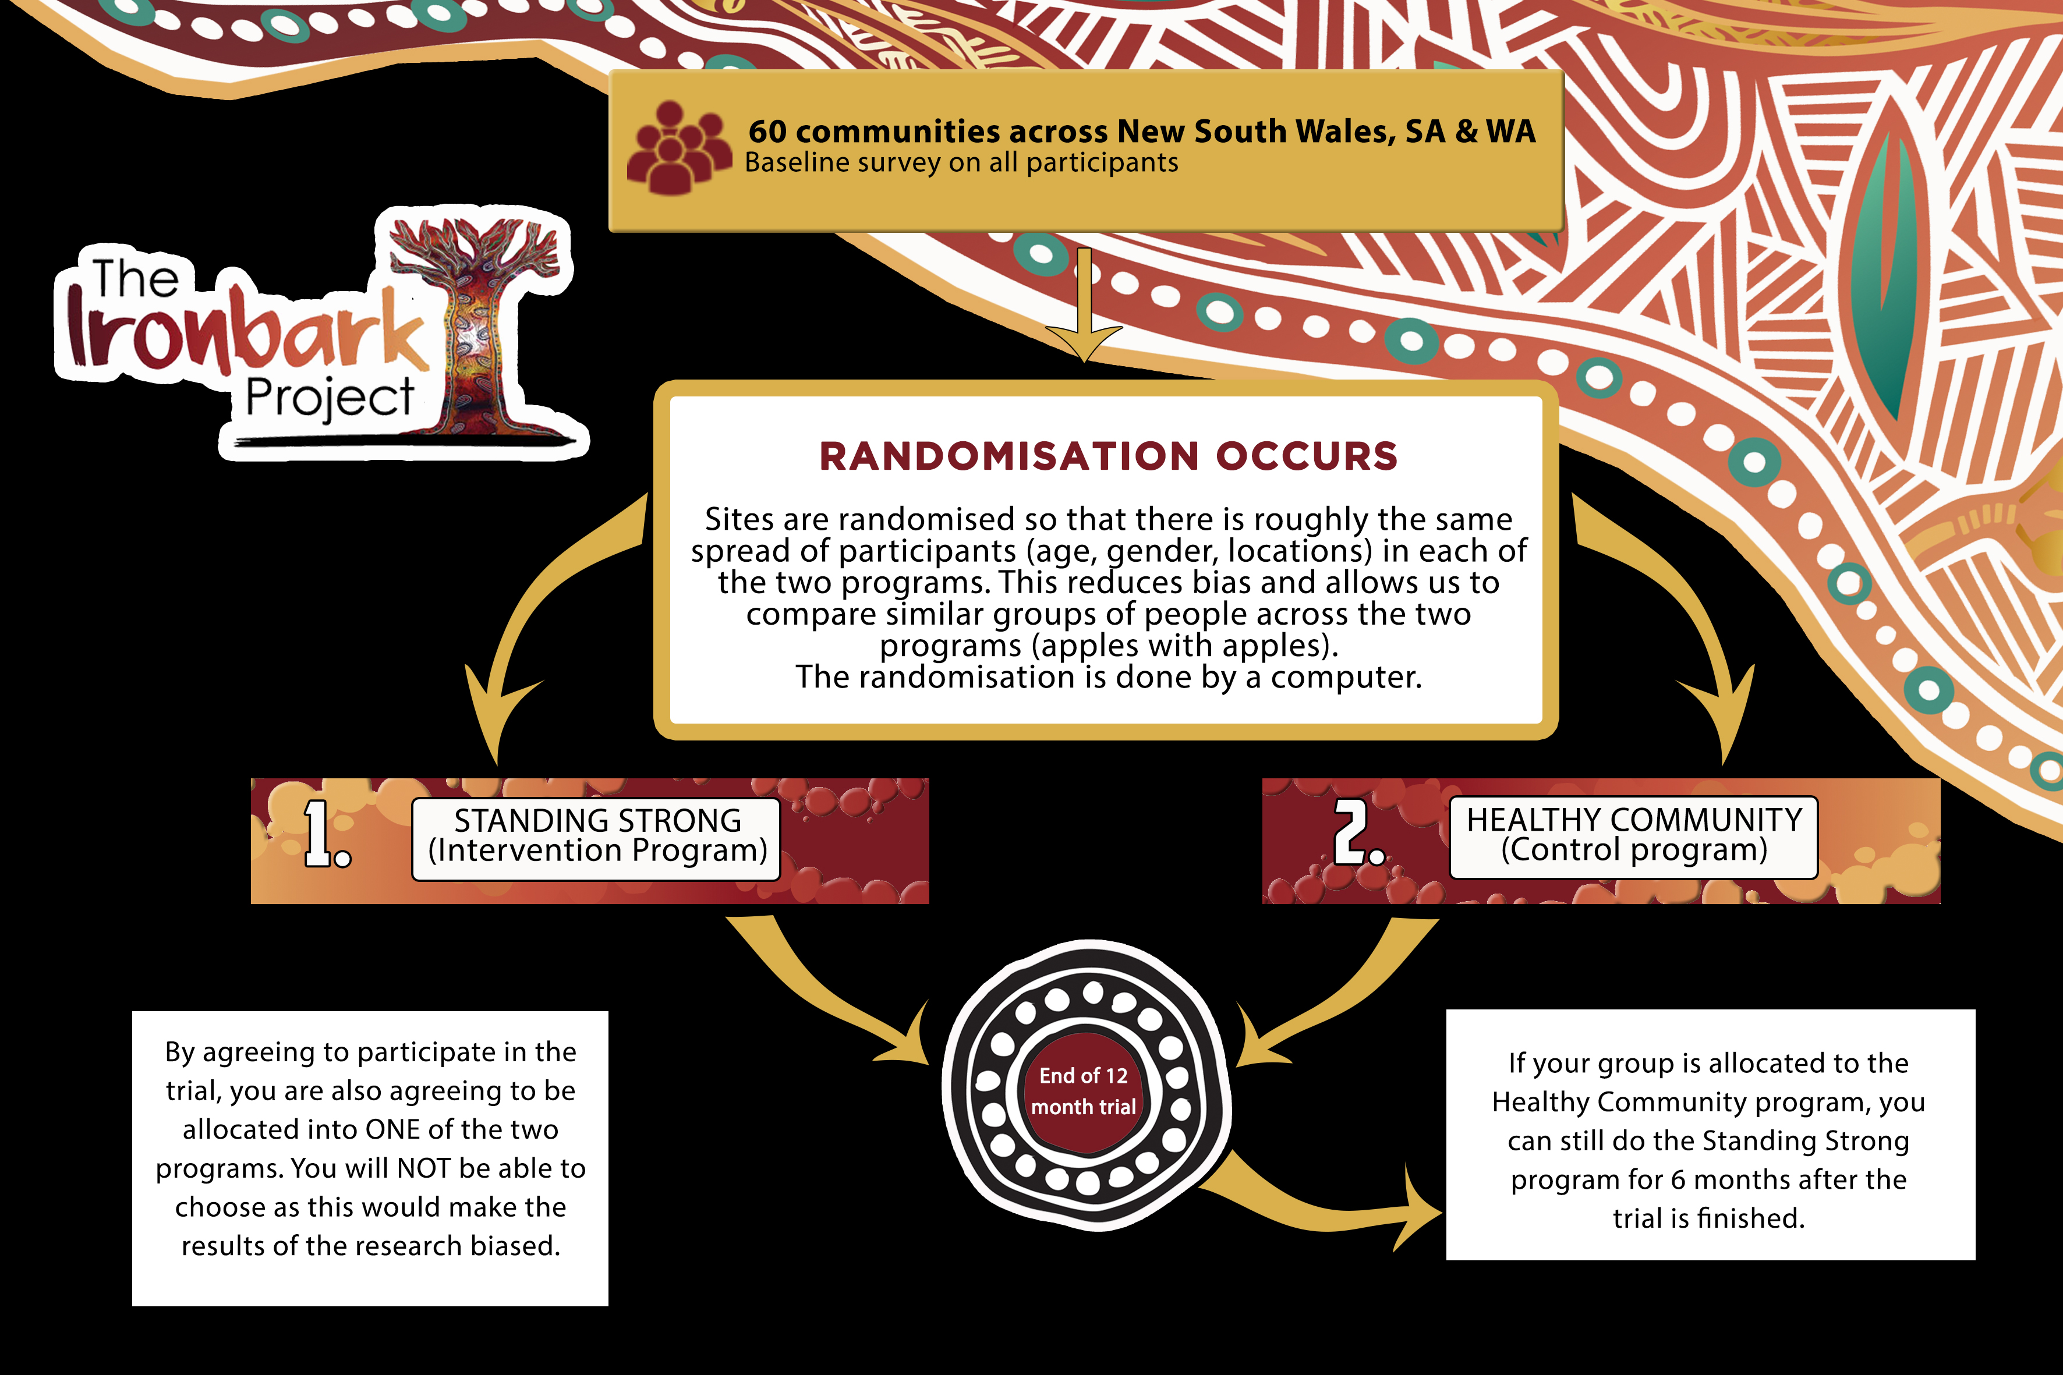

Slide 4
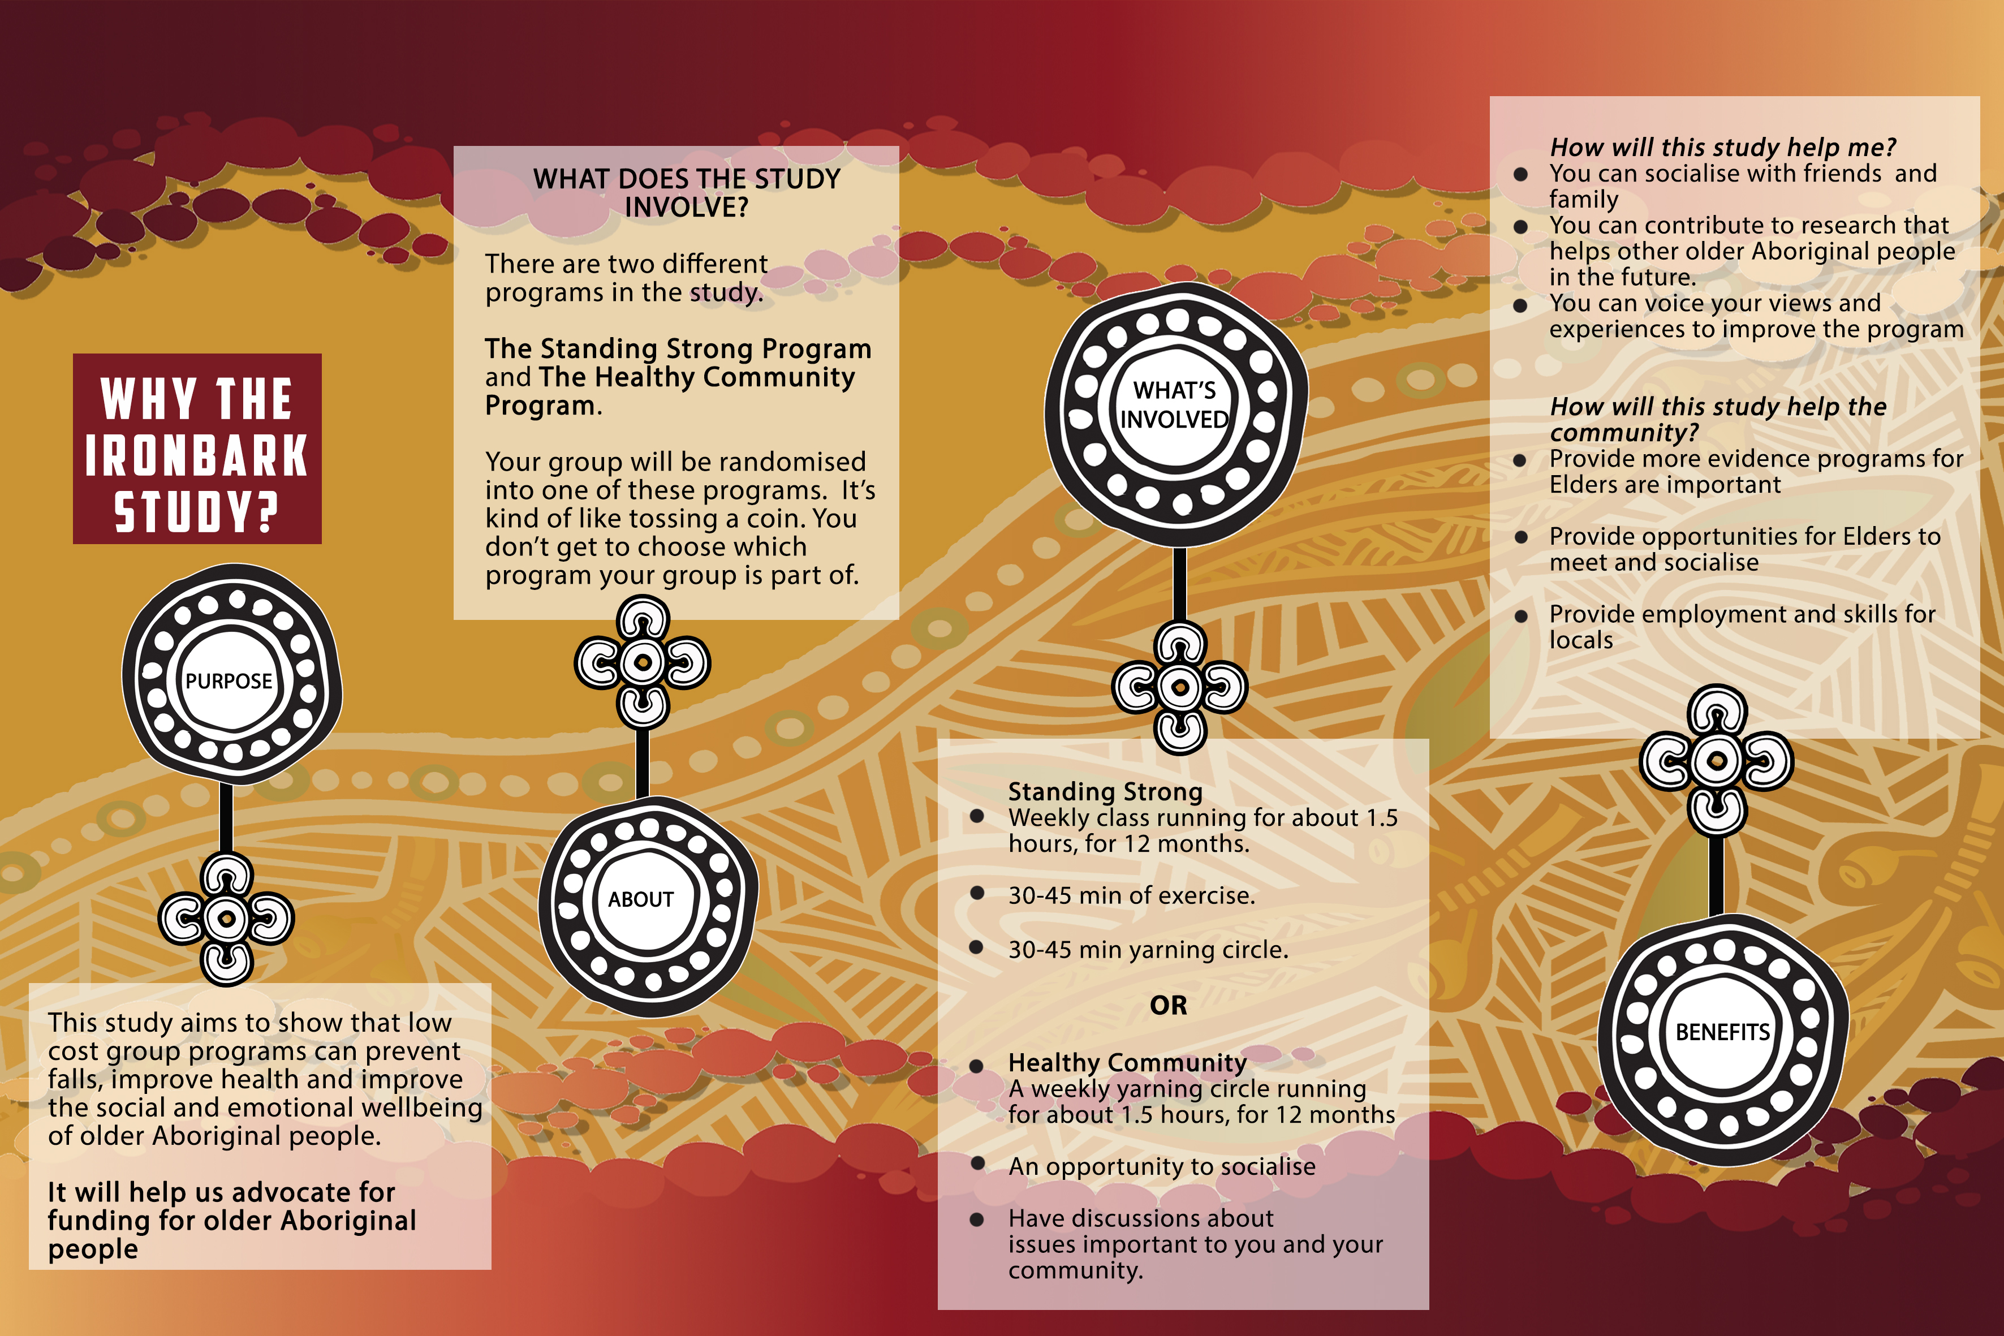

Slide 5
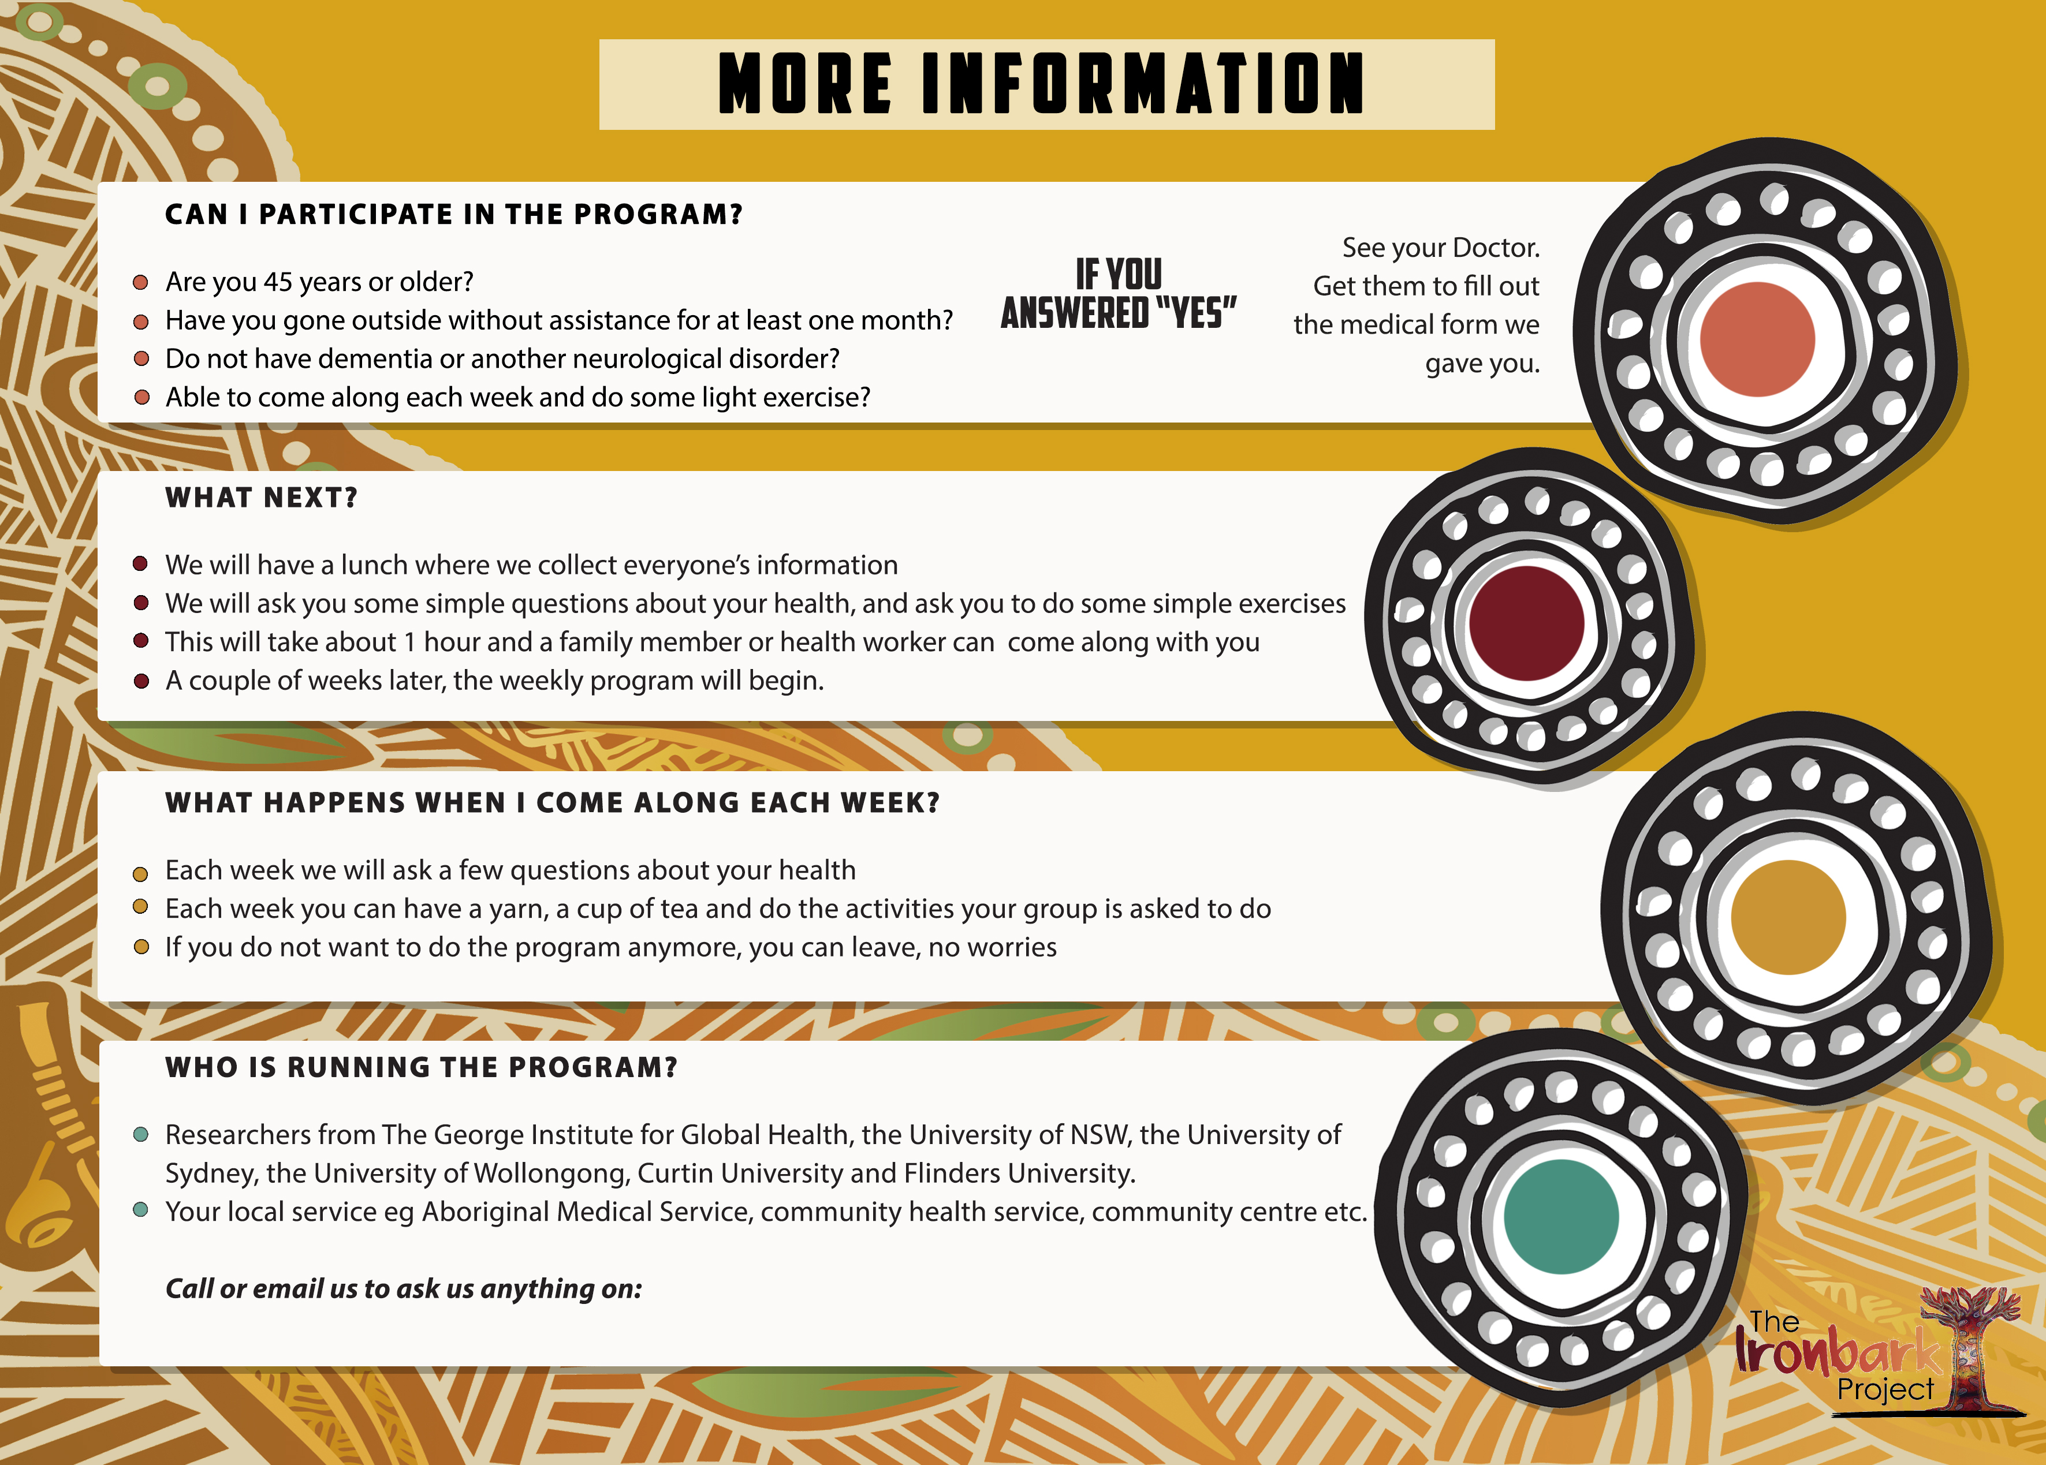

Slide 6
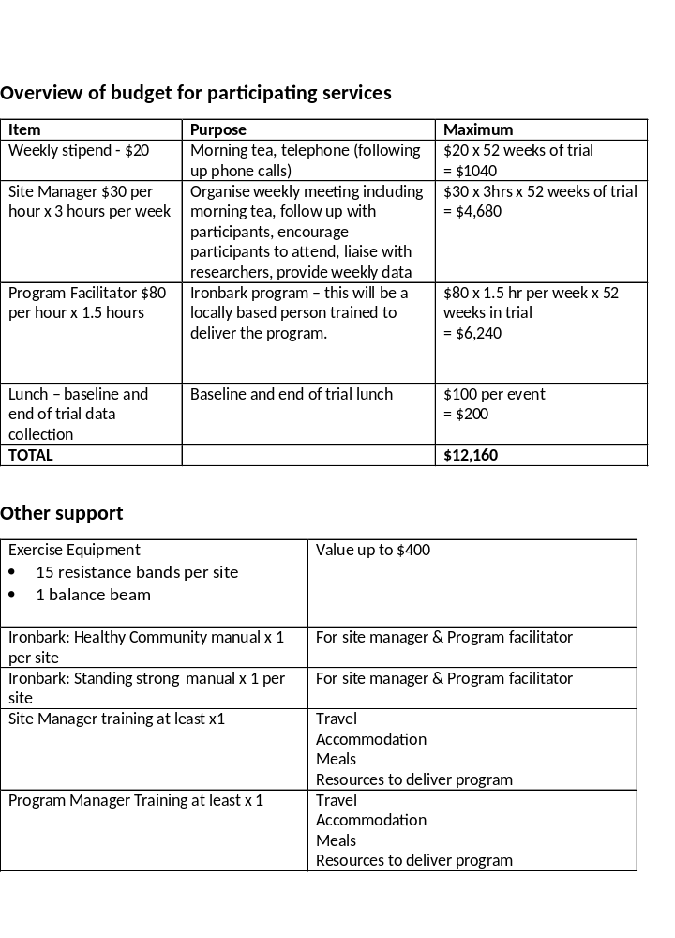

Slide 7
Feedback from participants in the original Ironbark Project
“There are not many programs that are culturally appropriate for us, you know, like especially in this area. This is the only program around here for us… “ – Female, Ulladulla
“It’s helped me socialise, it’s helped me be around other people. Since I retired, I have gone into my own shell. By doing this it’s made me get out more. We need these sorts of things to keep us going…” – Male, Ulladulla
“I love Tuesdays now. My son always asks ‘Why are you so happy
on Tuesdays?’ Cause of the exercises, sharing stories, you release
good endorphins so you are feeling good” – Male, Redfern

Slide 8
For more information:
www.ironbarkproject.org.au

